Slide 1
Quick Start Guide
Webshop B2B Ordering Portal
How to navigate and use the new ordering portal
Nov 2020 V1

Slide 2
Basic process of ordering a part
Login
Search the part/s you are after
View the details of the part (parts listing page/ listing details)
Add the part/s to your cart
View and review your cart
Go to the checkout
Process order
Uploading Excel Orders
*Please note all imagery and screen grabs in this presentation are for illustration purposes only

Slide 3
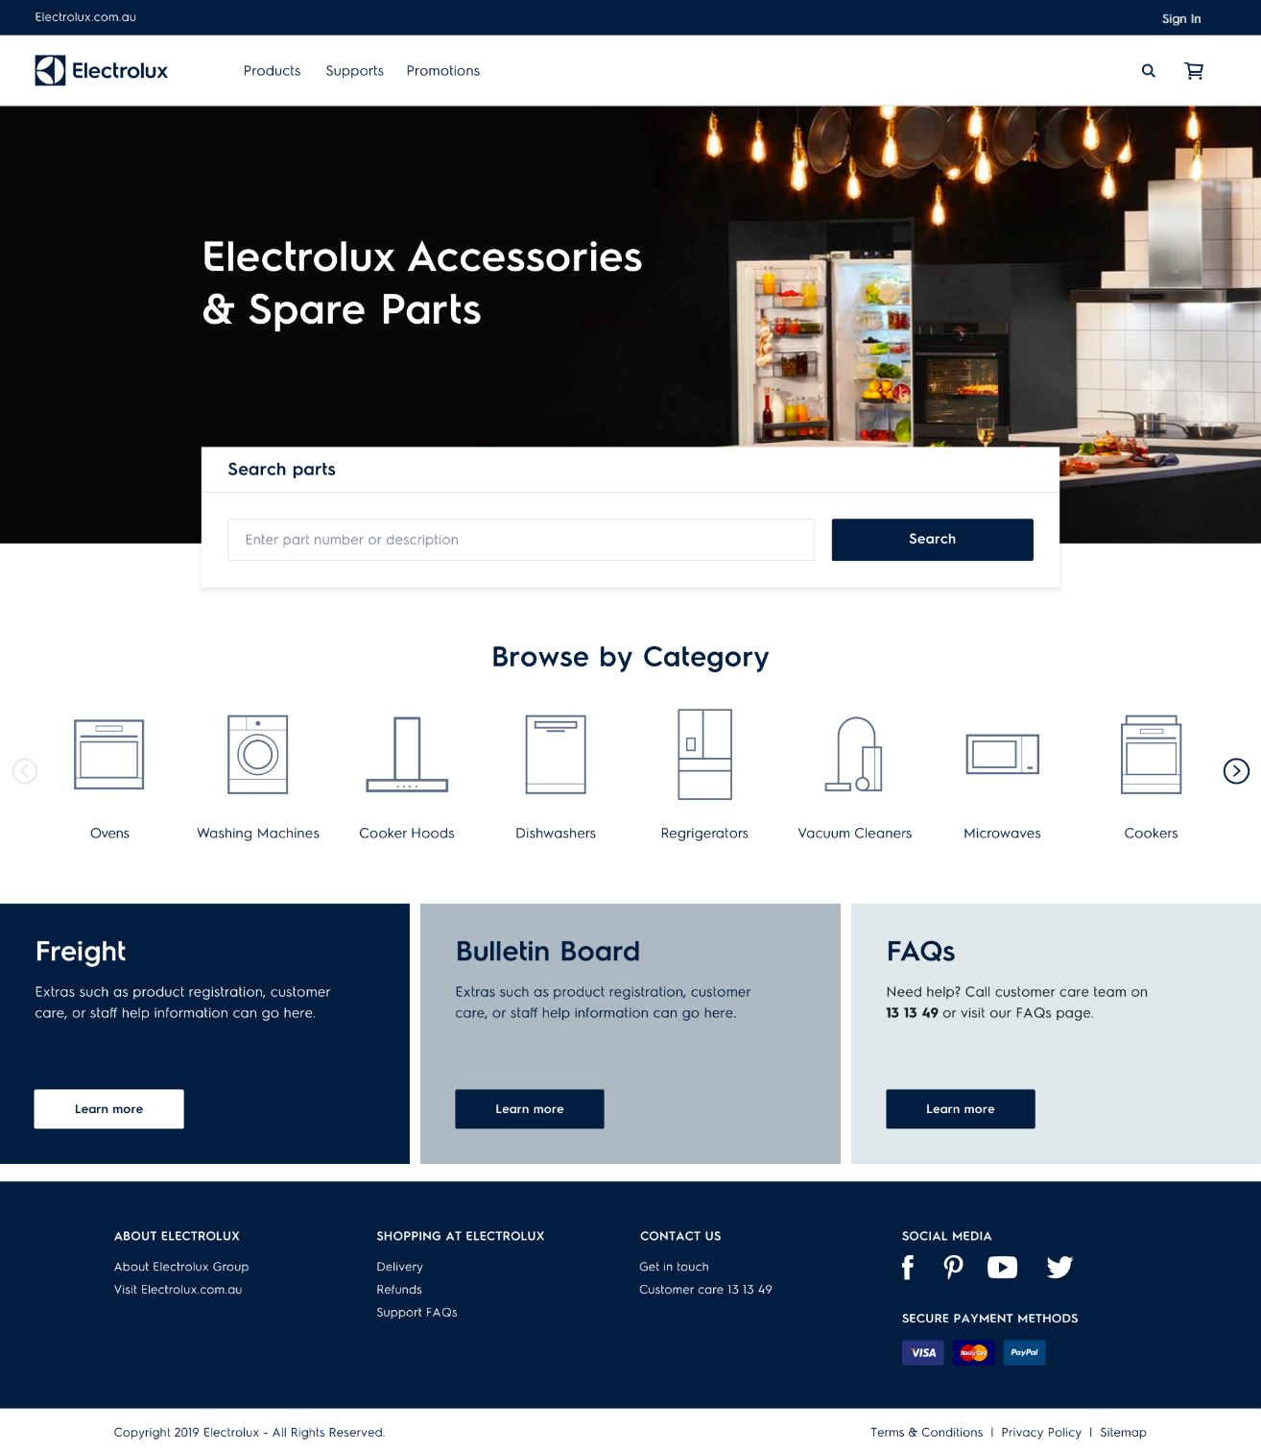
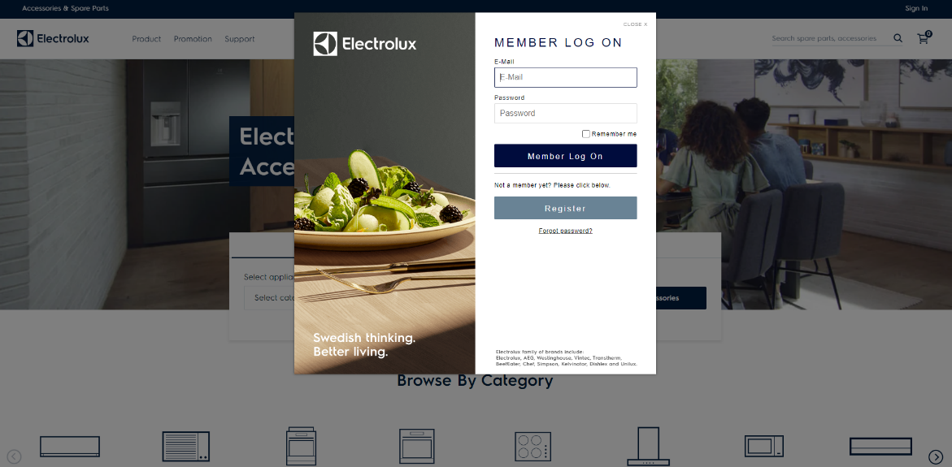
How to access the site and sign in
1
Login to your account by clicking the Sign in button in the top right-hand corner of the screen
To access the new ordering portal. Use URL: shop.spareparts.electrolux.com.au
The site is mobile responsive which means you can view and order parts from your mobile or desktop computer, whichever one you prefer.
2
The login screen will pop up. Allowing you to enter your credentials. These will be given to you once the site is live.

Slide 4
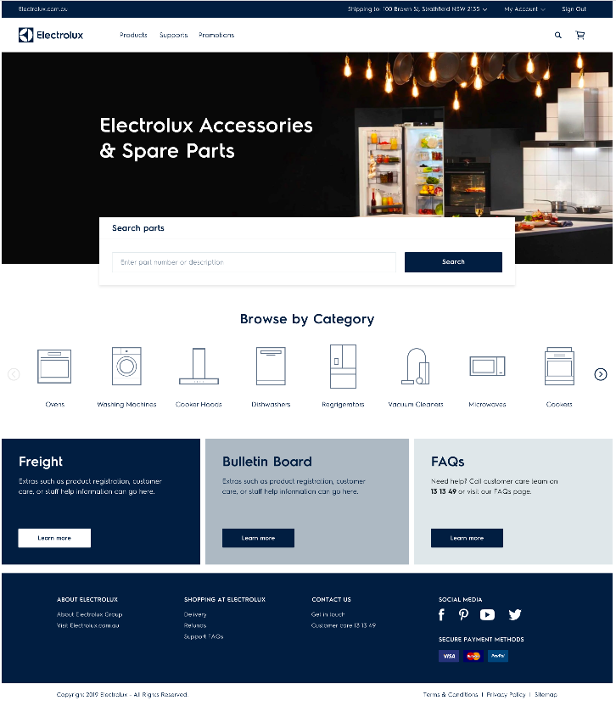
Homepage and how to search
View the products menu of all categories and parts categories
search
Use the universal search using part number, description, keyword or model
search
Enter a part or description in the search bar
search
Browse spares and accessories via category
View updates and important information.
Or use the footer to find out more

Slide 5
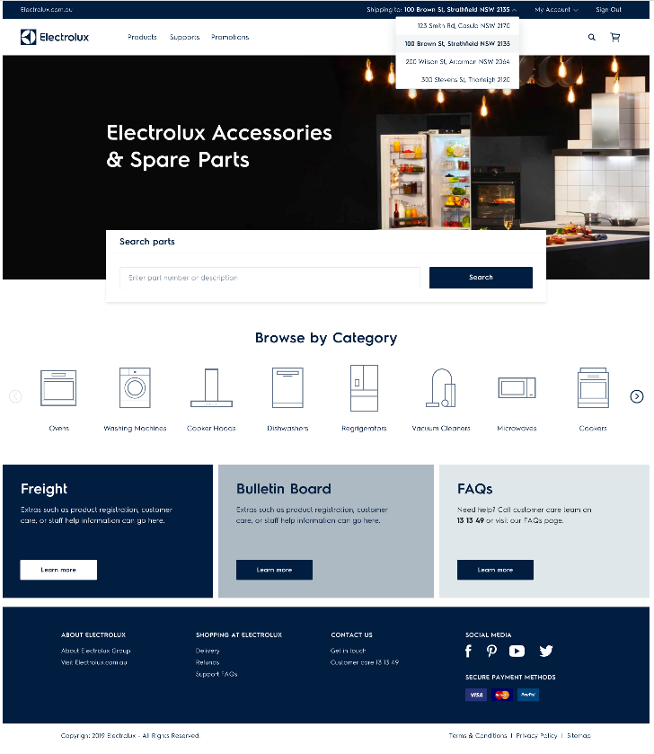
Choosing your address
You will have saved address/es in your account. Click here to bring up your shipping address. You can also add new a address to your account (this will be shown later)

Slide 6
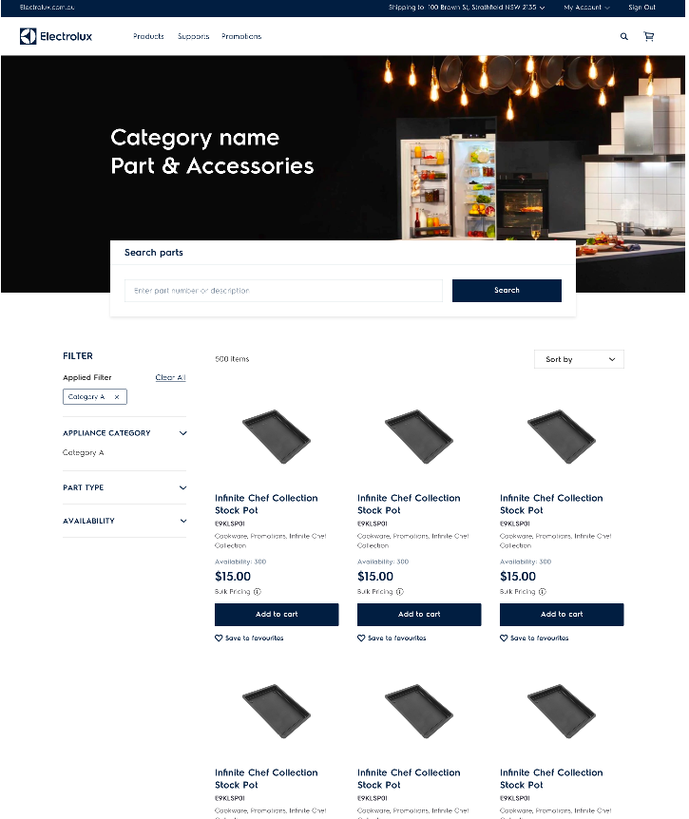
Parts listing page
The product listing page shows you search results from the homepage. Here you will see results of trays
Use the filters to narrow in on your search.
You can choose appliance categories, parts types (e.g. filters). And stock availability

Slide 7
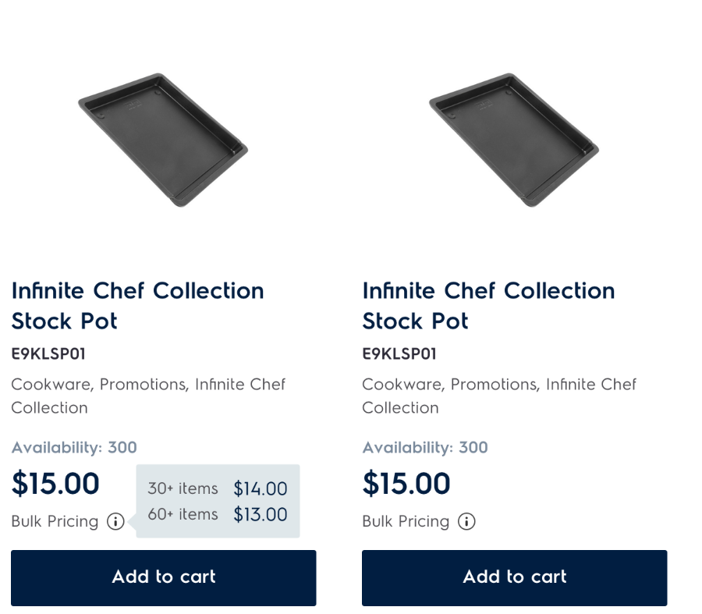
Parts listing page- expanded
Each listing will show you:
Part description
Part number
Categories it applies to
Availability
Price
Bulk pricing when you hover over the ‘i’ icon
Ability to add to cart
If this is the part you are after, click add to cart to continue to the next step

Slide 8
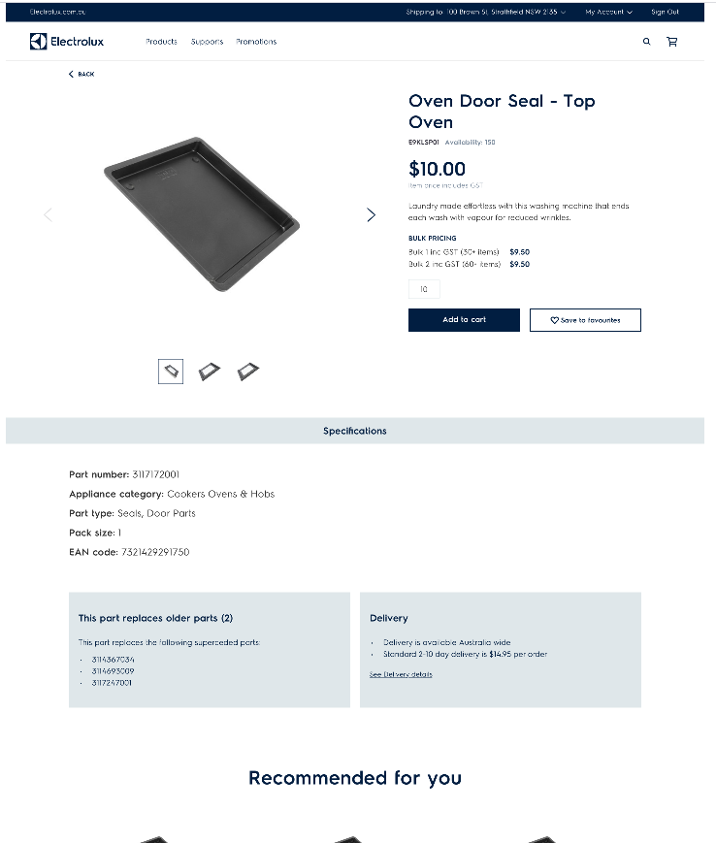
Part details page
This page shows all the details from the previous page. Plus specifications, supersedences and more information about the part and delivery
If this is the part you are after, click add to cart to continue to the next step
You can also save the part to your favourites

Slide 9
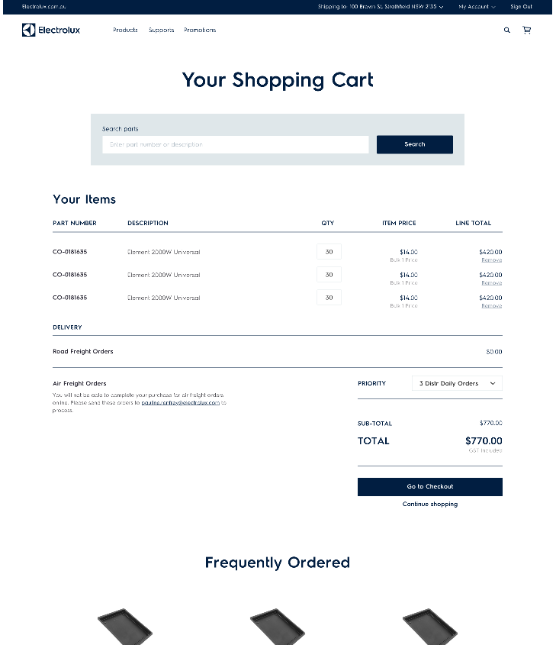
The shopping cart
To avoid freight charges your order value must be $350INC
Parts you have added to your cart display here
Prices & totals
A message will pop up advising on who to contact/where to send your order if you wish to have it air freighted
Go to checkout, or continue shopping button to go back to homepage and search
Use the drop down box to choose priority 1

Slide 10
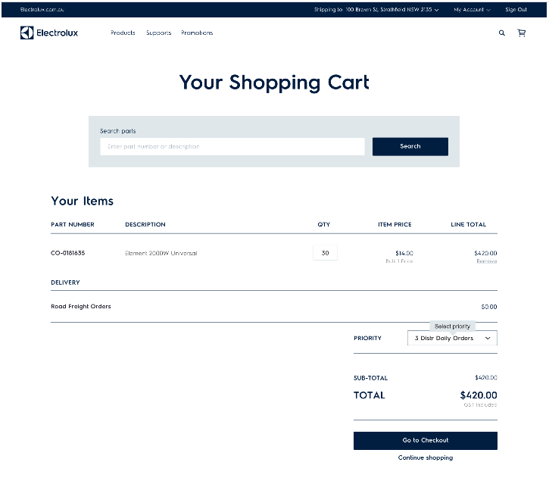
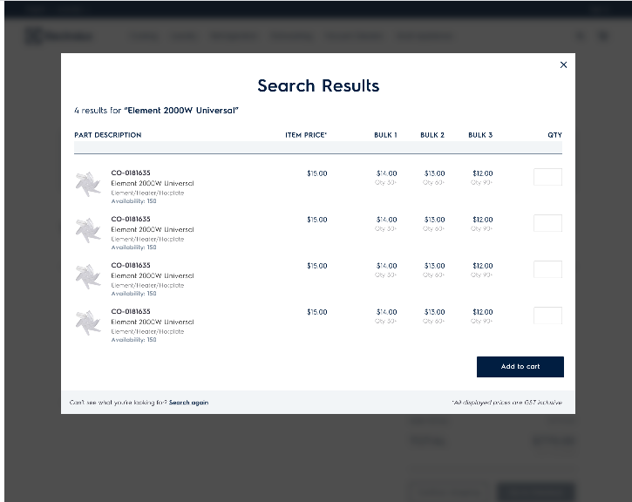
Adding to your cart
2
If you are not finished shopping you can simply search parts in the cart using this search bar
(by part number or description)
1
This is what your cart will look like
3
This is what your search result will look like in the cart
4
You can simply add these part/s and qty here

Slide 11
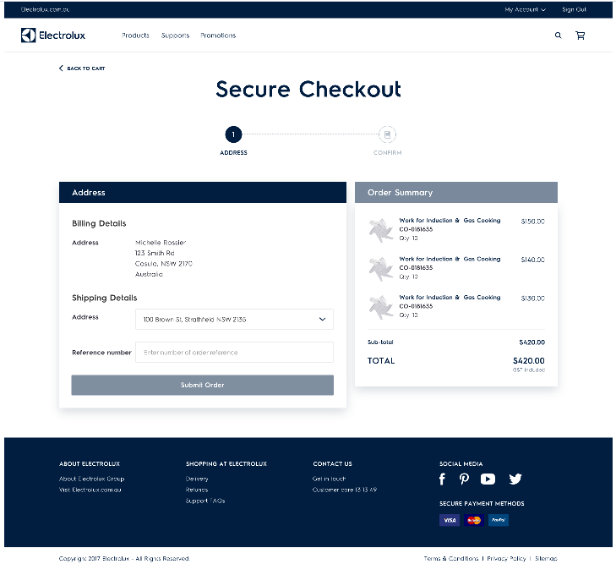
Checkout
‘BACK TO CART’ button to continue shopping
2 step checkout
Billing and shipping details
The reference number is your order number
Submit order button
Order summary

Slide 12
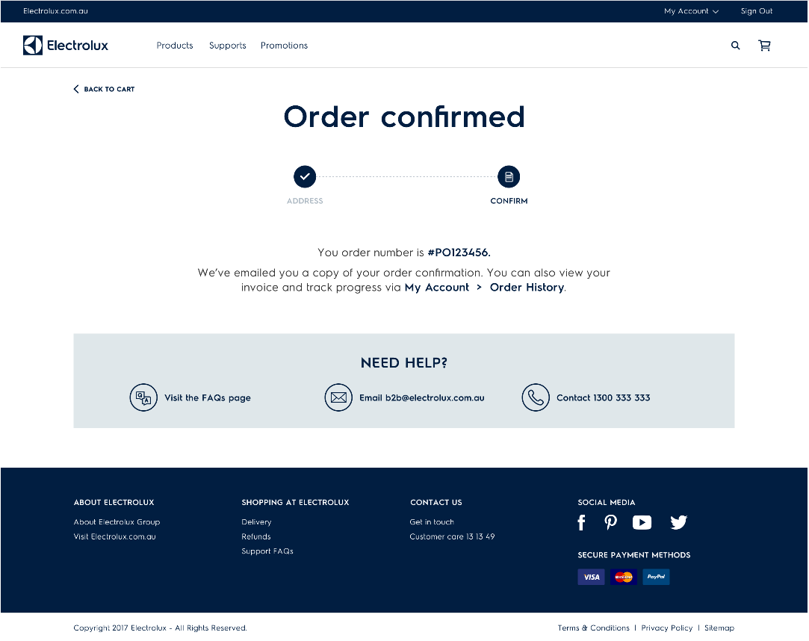
Order confirmation
This concludes the ordering process. Move onto the next page to see how to view your account, orders; and get support.

Slide 13
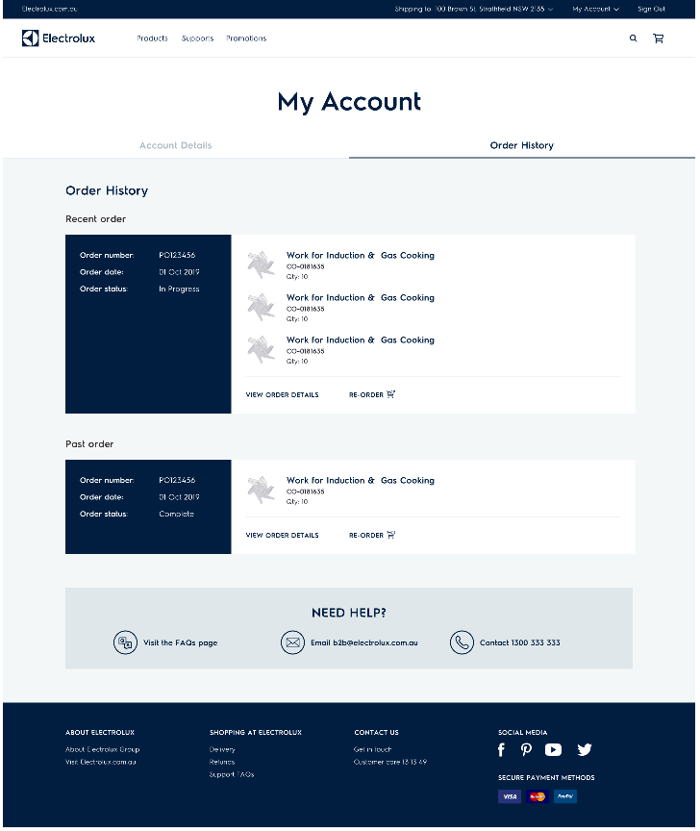
View your account
To view your account click on the My Account menu in the top right-hand corner of the page
You can see your
Account Details as well as Order History. You can toggle between these menus.
You can also view the order details and re-order

Slide 14
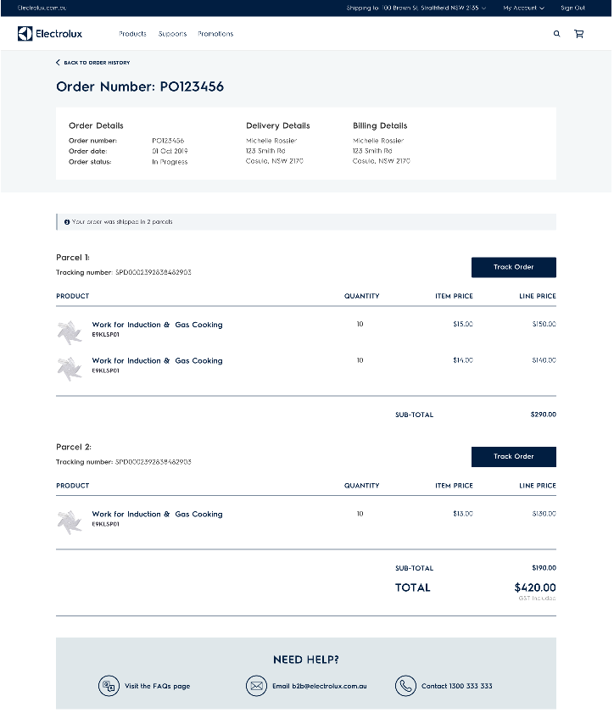
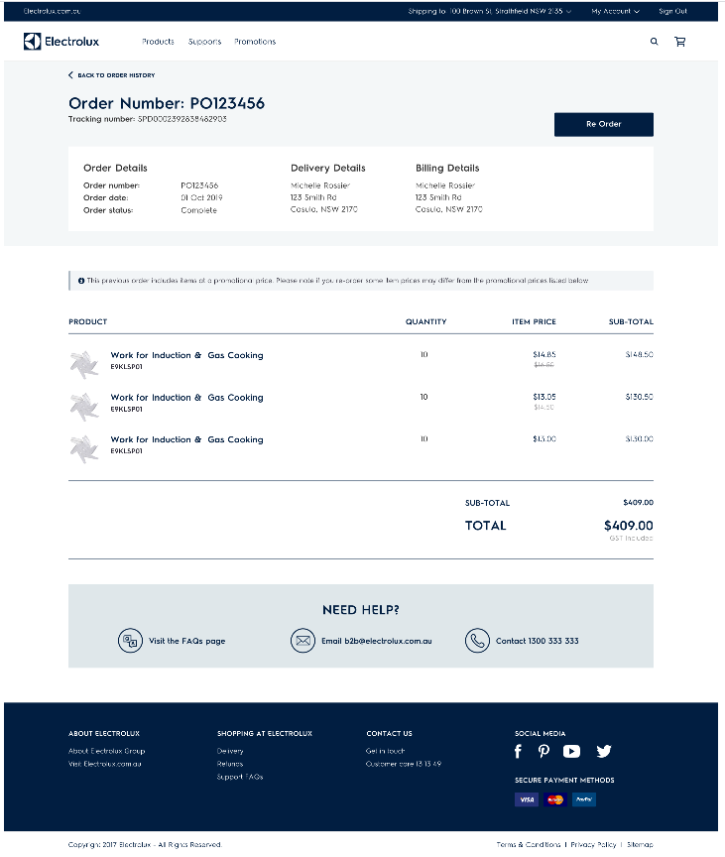
Viewing order status’ and re-ordering
You can simply
re-order a previous order by clicking here. The items from this order will add to your current cart and you can edit from there.
You can track the progress of your order shipments by clicking this button
Order in Progress
Past Order
There will be a pop up if there was a promotion on your previous order. This is to advise you the pricing may be different (if the promotion is no longer running)

Slide 15


Need support?
You can contact us for any support or issues with your order/s. Contact the tradeline team via email, or phone in on:
Trade.spareparts@Electrolux.com.au
1300 666 019
Please see the support menu for more information
Visit our FAQ’s if you need help with navigating the site
Email or call our team

Slide 16
Troubleshooting
If you appear too be having issues (see below) on the B2B Portal. Please try clearing your cache on your browser to rectify the error.
Possible issues:
Unable to login to your account
Unable to add items to your cart
Unable to find part/s in search
Unable to see pricing/correct pricing
How to clear your cache:
Go into your internet browser settings
Choose Privacy, Search & Settings/ Privacy settings
Clear browsing data and/or clear cache
Choose ‘All Time’ & Clear Now
NOTE: If you are using another browser, please use your selected browser settings menu to clear your cache.
Try using the portal in another browser, if the issue continues.

Slide 17
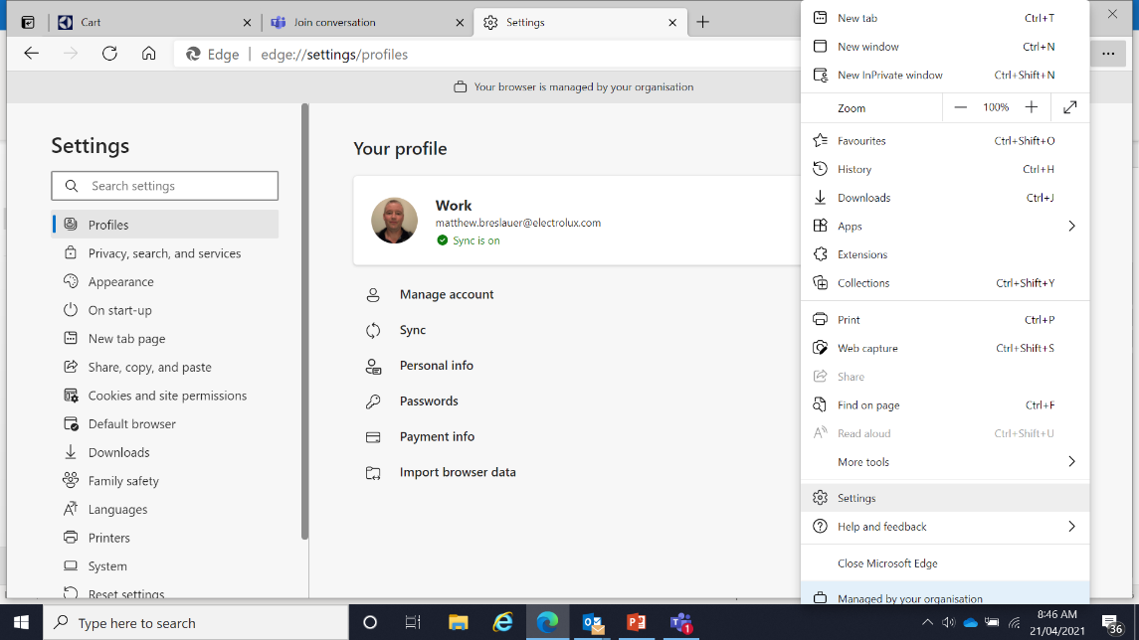
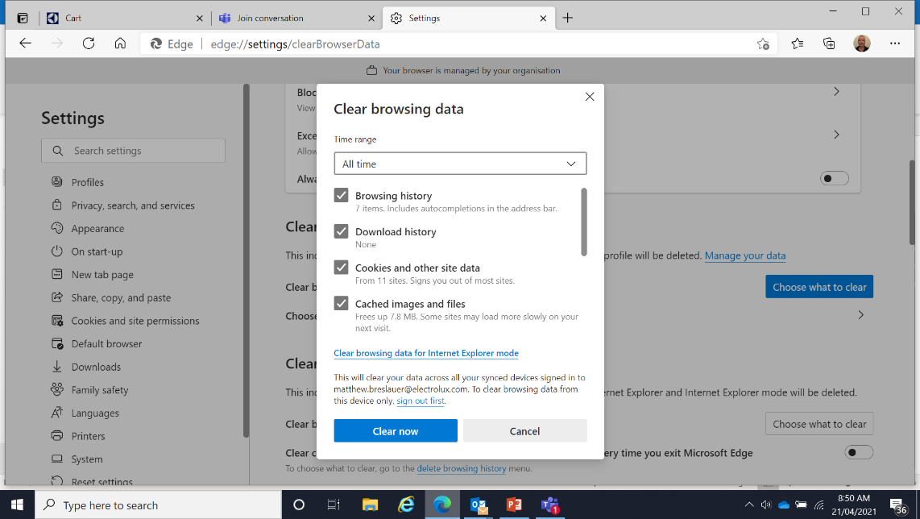
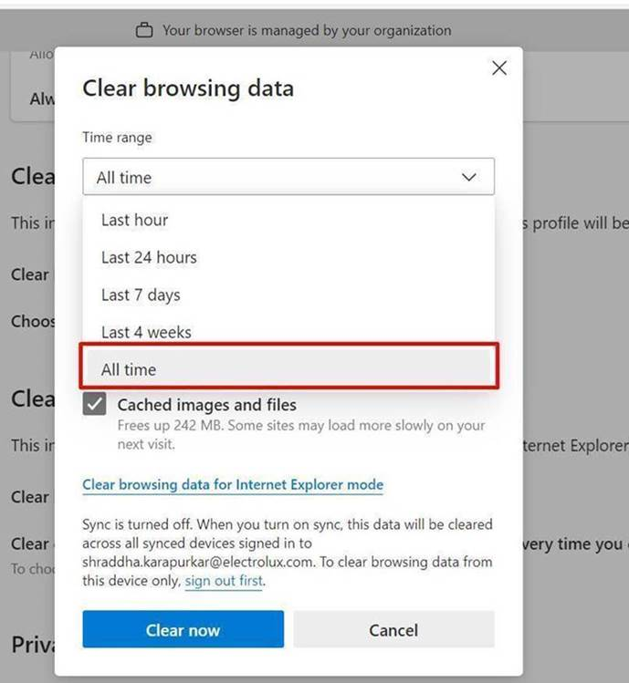
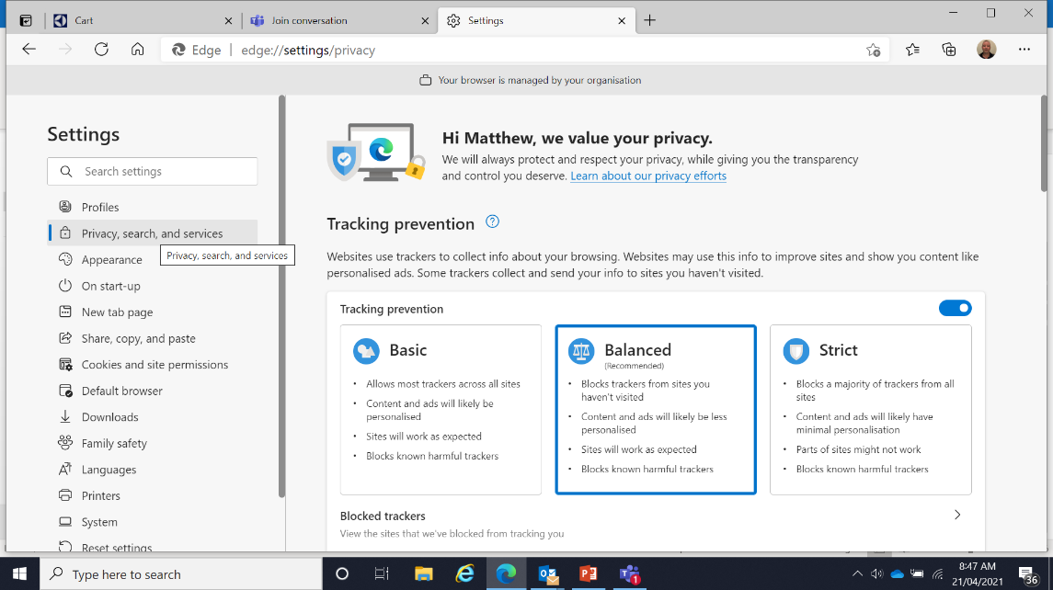
Troubleshooting- Clearing Cache
1
Go into your internet browser settings
3
Clear browsing data and/or clear cache
2
Choose Privacy, Search & Settings/ Privacy settings
4
Choose ‘All Time’ & Clear Now

Slide 18
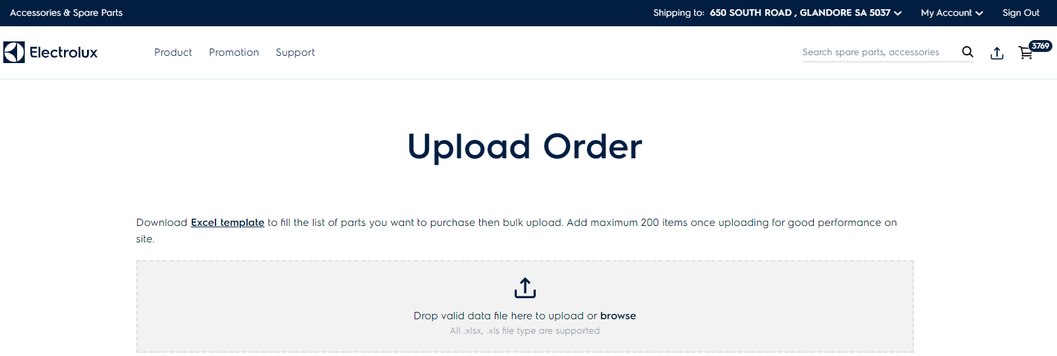
Uploading Excel Orders
First step to upload
Select up arrow
Please note - Add maximum 200 line items for better uploading performance on the site.
Second step to upload

Slide 19
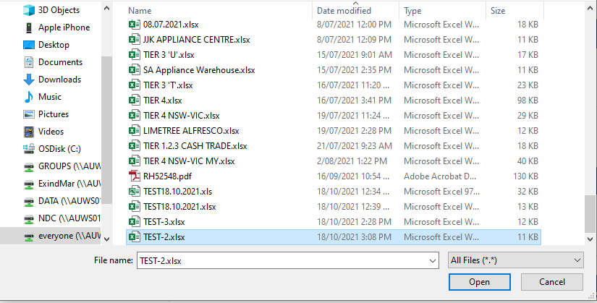
Uploading Excel Orders
Select file to be uploaded –

Slide 20
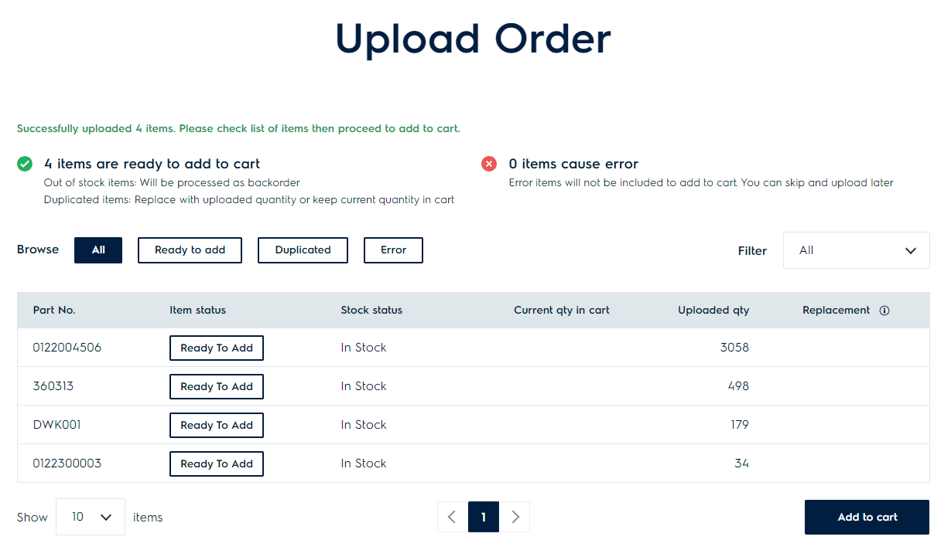
Uploading Excel Orders
Check part number /quantity and add to cart
Once confirmed – click Add to Cart

Slide 21
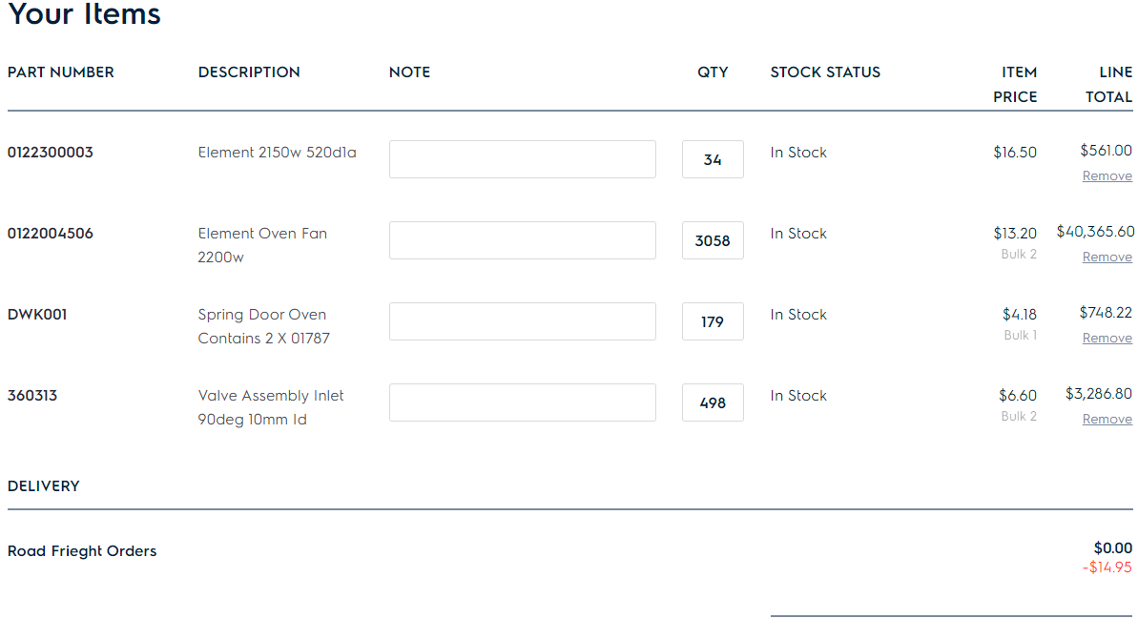
Uploading Excel Orders

Slide 22
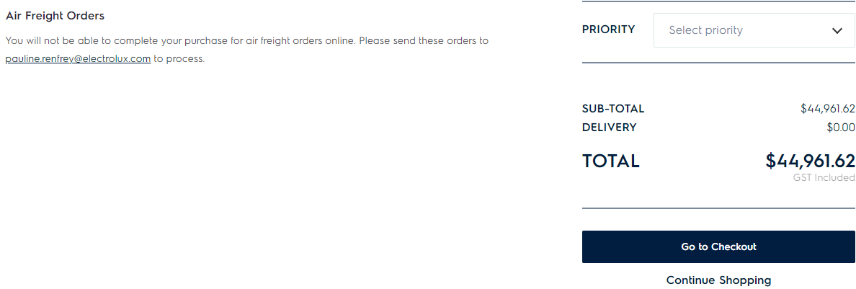
Uploading Excel Orders

